Slide 1


Online Appointment and Record System Demo
Kayla Heady - Carl Lazzeri - Kateryna Hrishina

Slide 2
Agenda
Normal User (Patient)
Creating an Account.
Booking an Appointment (and field).
Prescription Viewer.
Admin Account (Doctor)
Dashboard.
Admin Tools.
Analytics.

Slide 3
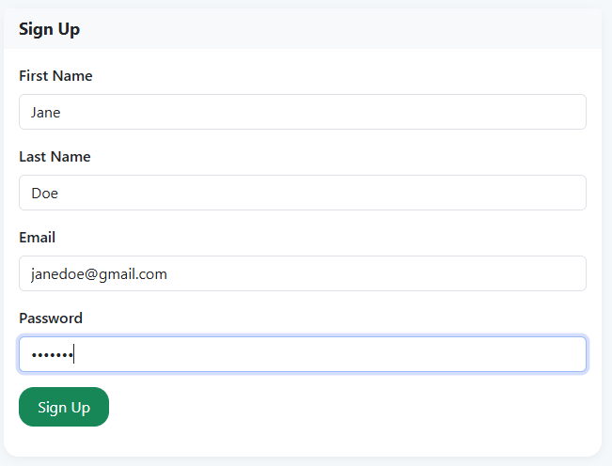
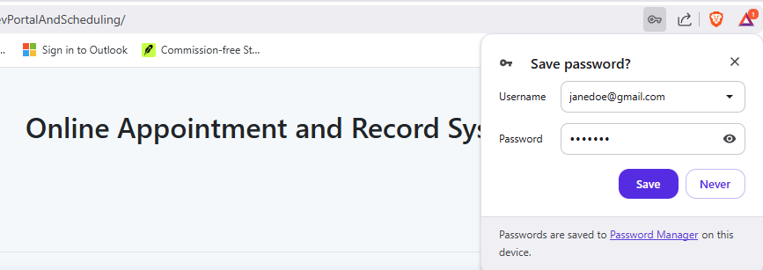
Normal User Creating an Account
Any person can create an account, simply using their First Name, Last Name, Email, and a Password. This will automatically insert the new user into the database. In legacy versions, an email confirmation was required, however this was discontinued.

Slide 4
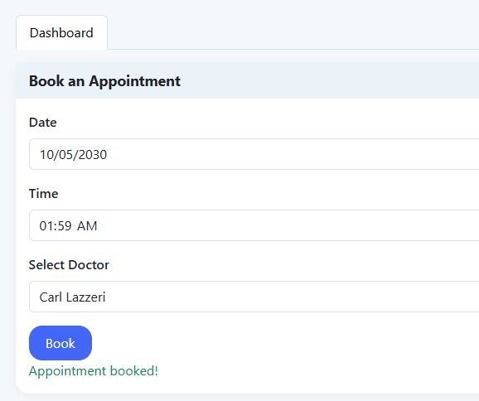
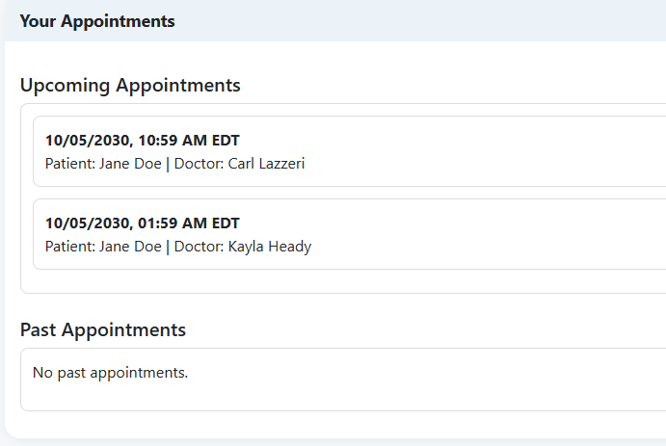
Normal User Booking an Appointment (and field)
A patient can book an appointment. This appointment requires a date, a time, and a doctor (queried from database). This will check for schedule conflicts by looking at the selected doctor and comparing times.

Slide 5
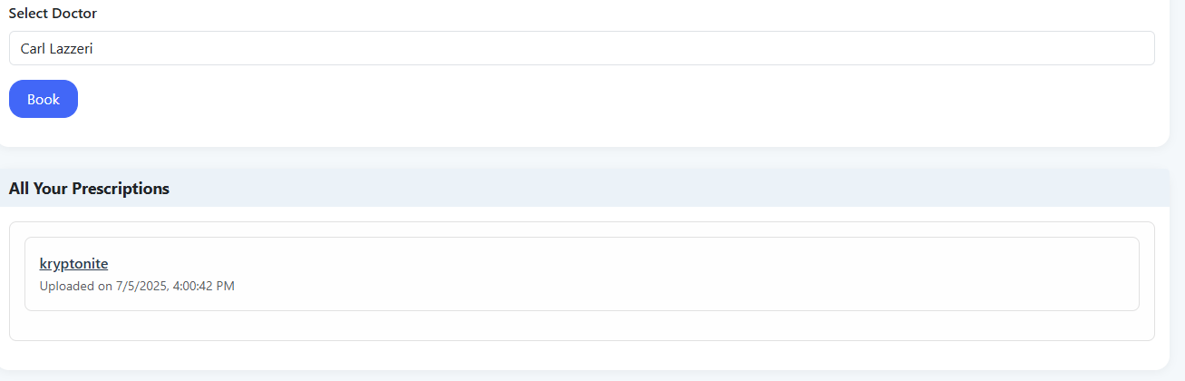
Normal User Prescription Viewer
A user can download and view a prescription assigned to them by a doctor. This creates a full cycle web app. Beginning from account creation -> appointment -> appointment remarks (by doctor) -> interactive prescription.

Slide 6
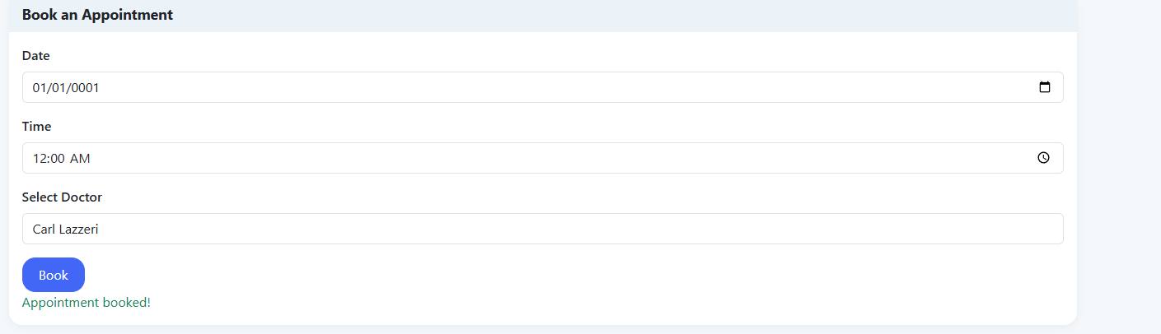
Admin Account Dashboard - Appointment
Just like a normal user (patient), a doctor can also schedule an appointment (including oneself.)

Slide 7
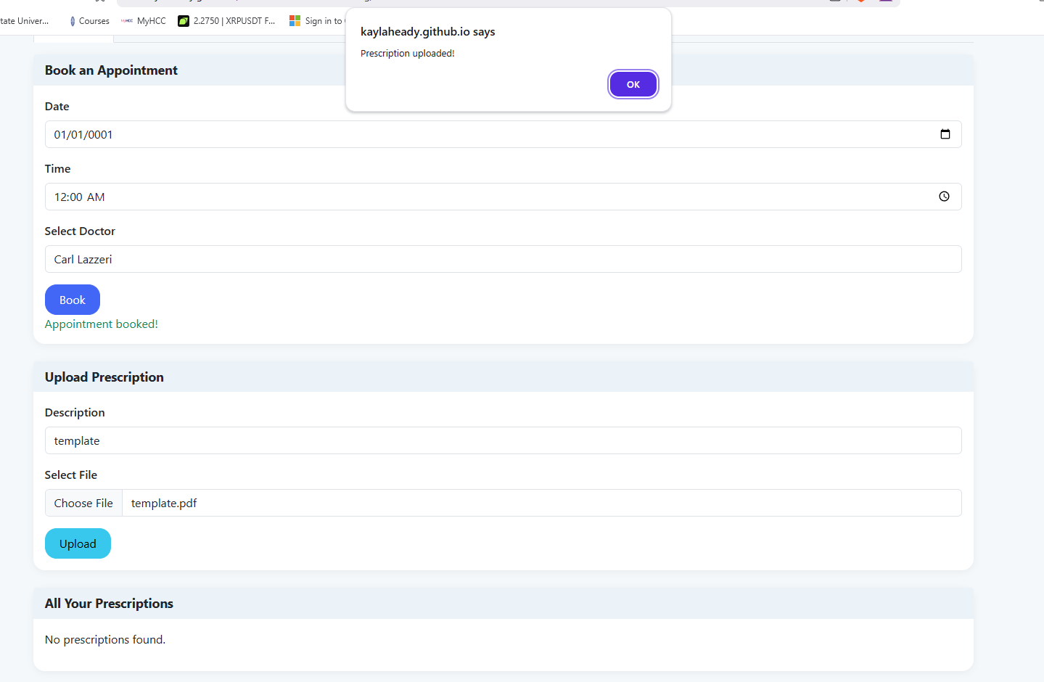
Admin Account Dashboard – Upload Prescription
The admin account (doctor) can upload prescriptions to the database, then manually assigned to a patient for them to view.

Slide 8
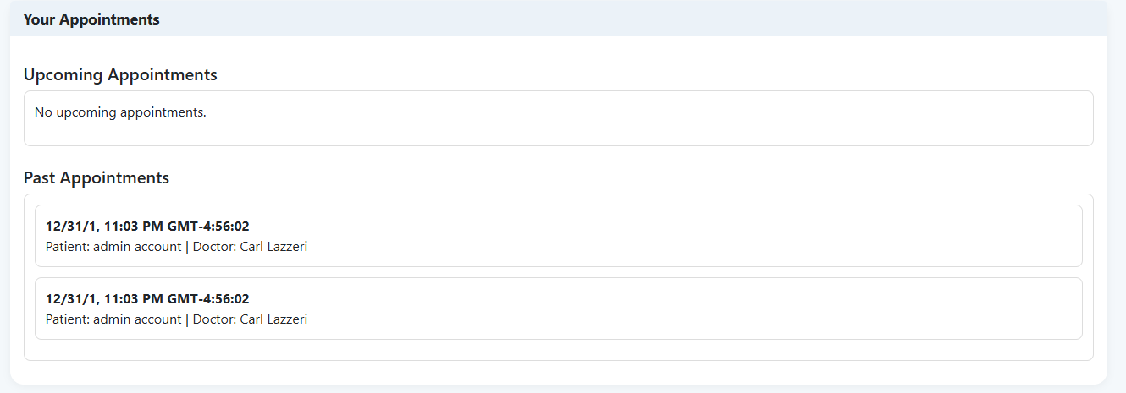
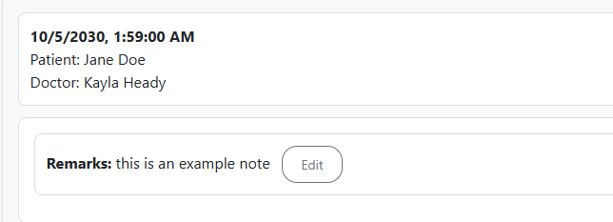
Admin Account Dashboard - Appointment
Just like a normal account (patients), admin accounts (doctors) also have an appointment panel. An admin can also edit descriptions within an appointment, acting as a notepad for doctors.

Slide 9
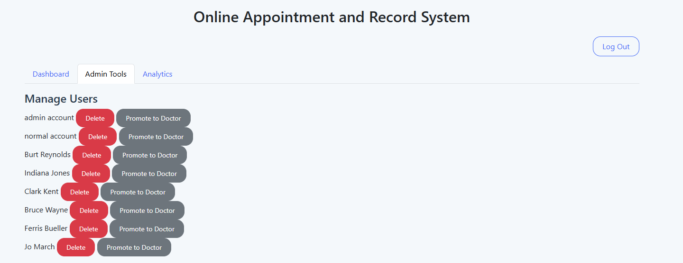
Admin Account Admin Tools – Managing Users
An admin account can promote, and demote users from simply being an authorized user, to a patient, and finally to a doctor

Slide 10
Admin Account Admin Tools – Managing Users
An admin account can promote, and demote users from simply being an authorized user, to a patient, and finally to a doctor. Once a user is promoted to doctor, they must manually be demoted, a doctor cannot change other doctors' role for security purposes.

Slide 11
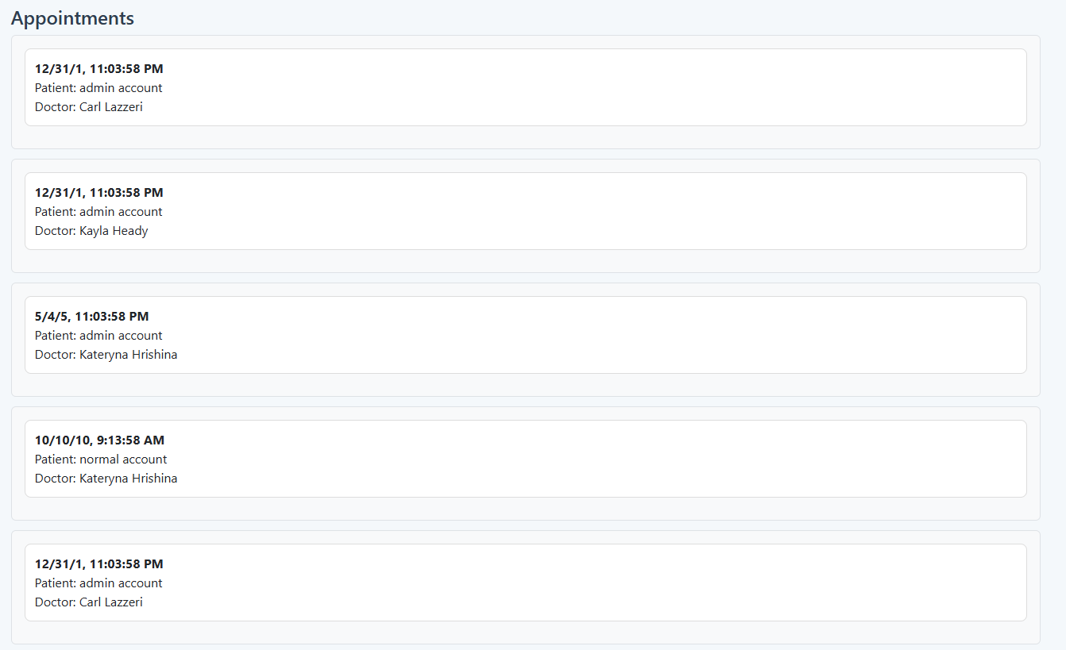
Admin Account Admin Tools – Appointments
All doctors can see ALL appointments in the database, including those of other doctors.

Slide 12
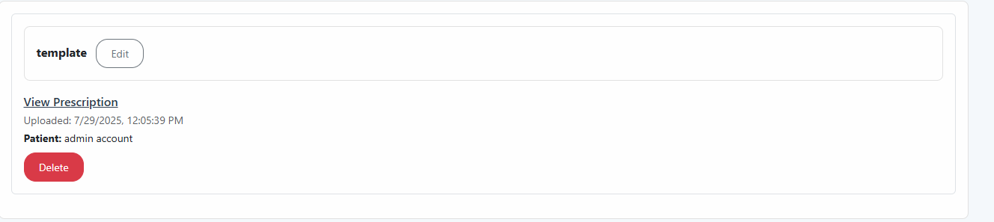
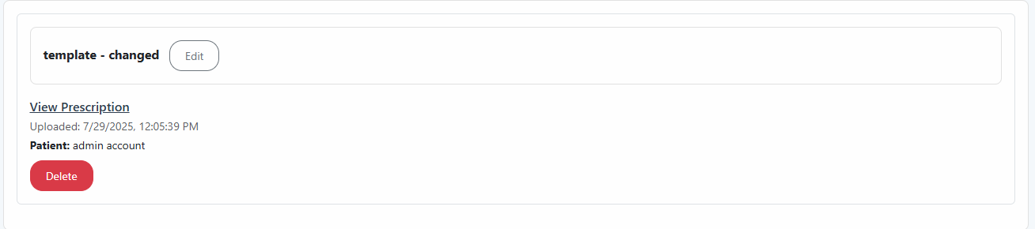
Admin Account Admin Tools – Prescriptions
Doctors can see ALL prescriptions in the database, and change the description, as well as viewing the prescription.

Slide 13
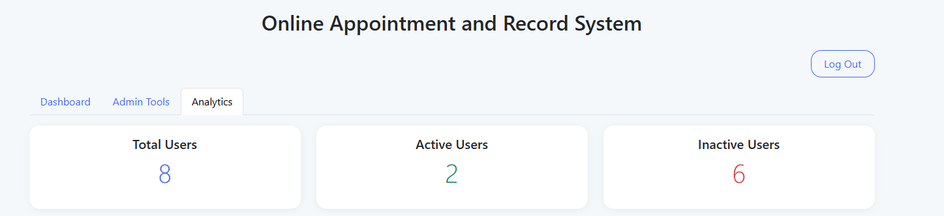
Admin Account Analytics – User Details
The analytics tab offers the number of total users, as well as active users (interacted with the database exclusively), and number of inactive (total - active).

Slide 14
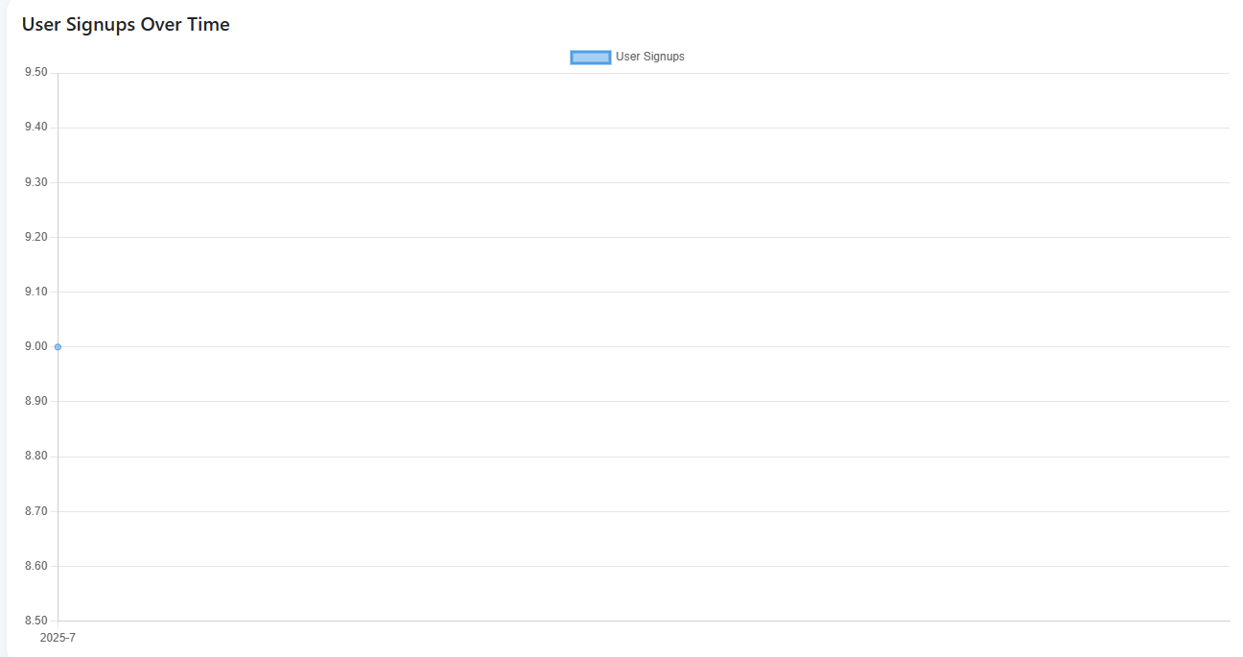
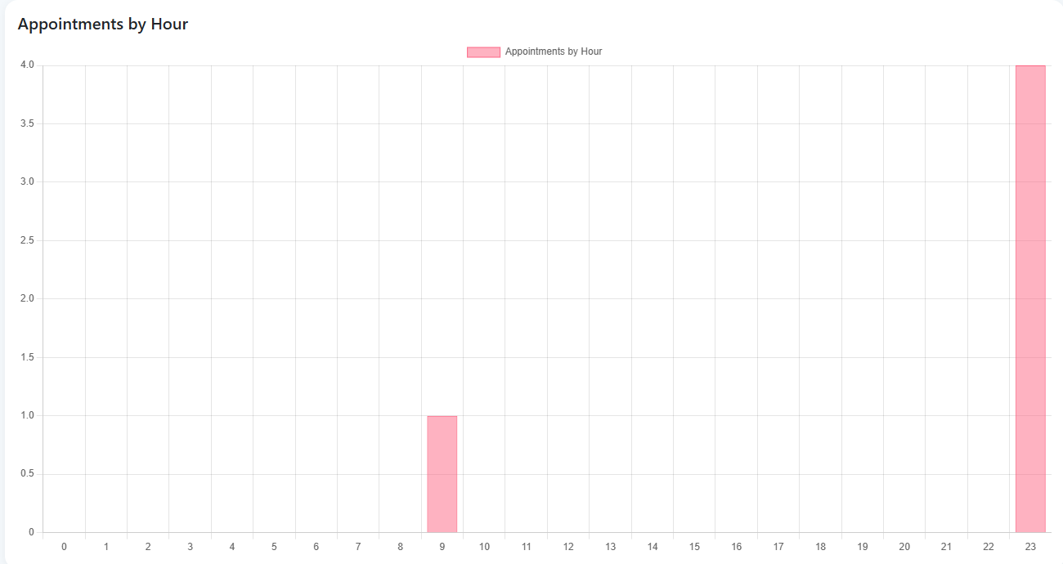
Admin Account Analytics – User Interaction
There are also working graphical representations for new users, and appointments scheduled in the database.

Slide 15
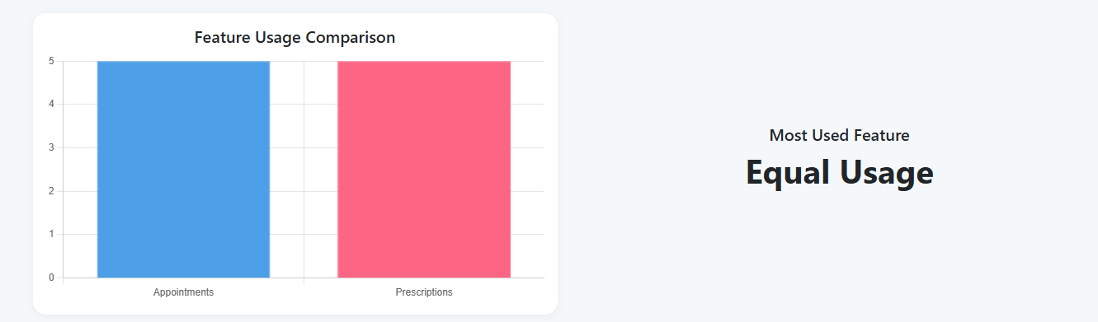
Admin Account Analytics – Used Features
The analytics tab offers insight towards the most used features on the app, which simply counts the number of prescriptions and appointments and compares them.

